Slide 1

Project- Modification to Garbage-Bin stands
Group Details
Name of students | BITS IDs:
Chaitanya Krishna Chauhan | 2020A4PS1869P
Alok Narayan | 2020A4PS0501P
Yash Anil Saboo | 2020A4PS0465P
Samikhya Nayak | 2019B5A40845P

Slide 2

Identified Problem
Cleaning And Organizing Is A Practice, Not A Project
In our campus, there are many bins in the bhavans. But still litter is found scattered at many places.
Dogs roaming in bhavans are able to push the dustbins out of their current stands and litter the garbage all around.
Also, the sanitation worker who come to collect the garbage has to manually pull out those bins by hand and empty them.

Slide 3
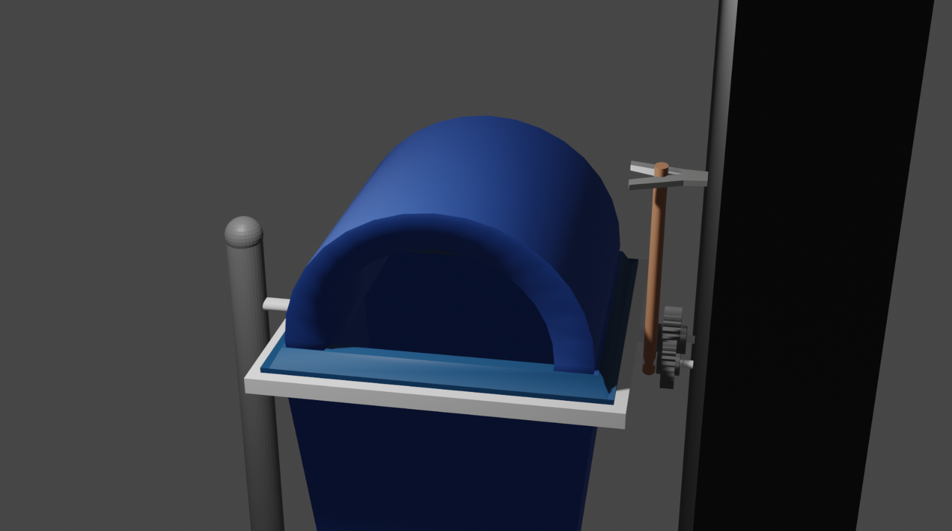
Possible Solution
Increasing the height will allow to make the toppling or lifting the bin out of stand difficult for dogs.
Adding a simple lock to prevent rotation of the handle and thus the bin itself.
Gear mechanism to increase convenience in empting the bin.

Slide 4
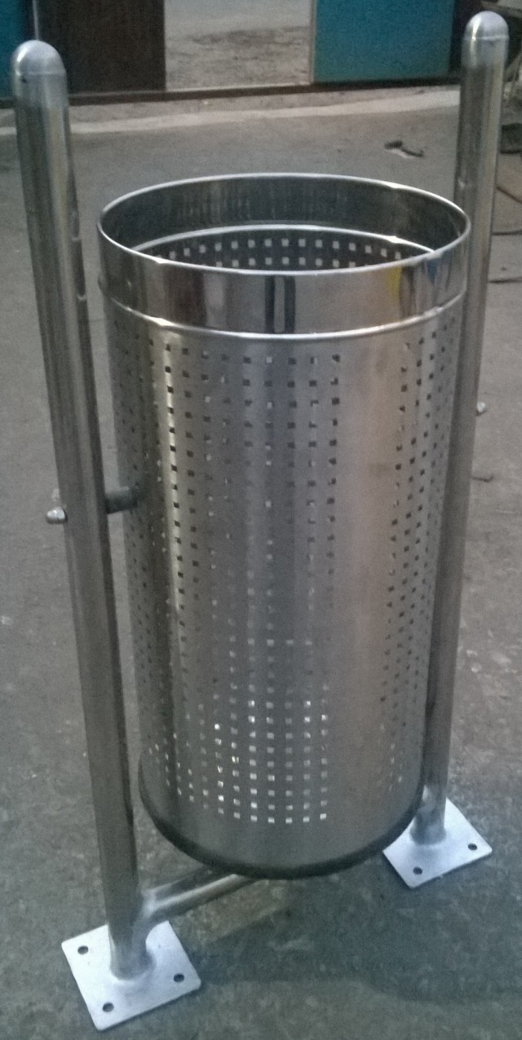
Products in Market
Given below is a product which is little similar to our solution but not clearly same
Brand Name : Fibrecrafts India
Type of Product : Dustbin
Sub Type : Pole Mounted Perforated Dustbin
Height : 3.5' Height
Material : Stainless Steel

Slide 5
Novelty
Differentiating factors:
No way to rotate the dustbins without touching.
The handle and gear mechanism
Prevent dogs from spilling the litter all around.
Increased height
Lock mechanism
Simply not usable for the bins present in our campus
Use of current bins

Slide 6
Thank you

